Slide 1
Linux Essentials
For Developers

Slide 2
Setting Context

Slide 3
Audience Pulse
Background:
Web Development
Hardware Software Interface
SysAdmin
Devops
Embedded Software
Desktop Applications
Testing
Era:
Amateur Radio/Silicon
Desktop
Web
Mobile
Voice Assistants, Kinect, VR/AR+

Slide 4
Audience Pulse
Level of Experience:
Novice
Beginner
Intermediate
Expert

Slide 5
Audience Pulse - Expectations
Know what it is.
Should be able to use it.
Master it.
Hack?
Contribute back.
Identify opportunities for a startup.

Slide 6
Friends & Competition
EDX: Introduction to Linux
Linux Journey: Home
Open Source Software Development, Linux and Git
Operating Systems and You: Becoming a Power User
The Unix Workbench
Linux Server Management and Security
Linux Fundamentals, Part 1

Slide 7
A developer is an individual that builds and create software and applications. He or she writes, debugs and executes the source code of a software application.
A 10x developer is an individual who is thought to be as productive as 10 others in his or her field.
Notes:
Compare with a Driver. The driver not only needs to know how to drive a vehicle, but also troubleshoot the vehicle in need. Knowing the layout of the area/roads is also important for 10x.
If he can handle the anti-social elements on the road, it’s a plus.

Slide 8
How 10x?
Write Faster?
Keyboard Shortcuts?
Better Design Decisions
On the Shoulders of Giants
Focus - Build vs Buy
Granular Control
Automation
Better Tools
One of my primary objects is to form the tools so the tools themselves shall fashion the work and give to every part it’s just proportion.
Eli Whitney

Slide 9
Interesting Reads
Beating the Averages by Paul Graham
How to become a Hacker by Eric Steven Raymond
Cathedral and the Bazaar by Eric Steven Raymond
Why Software should be Free by Richard Stallman
Software Licenses & Uncopyright
Comparison of free and open-source software licenses
Notes:
https://www.whoishostingthis.com/resources/copyright-guide/
https://en.wikipedia.org/wiki/Alice_Corp._v._CLS_Bank_International#Supreme_Court_opinions
https://www.ted.com/talks/lawrence_lessig_laws_that_choke_creativity?language=en & https://en.wikipedia.org/wiki/Free_Culture_(book)

Slide 10
Interesting Watch
Triumph of the Nerds
Nerds 2.0.1
Notes:
https://en.wikipedia.org/wiki/Triumph_of_the_Nerds
https://en.wikipedia.org/wiki/Nerds_2.0.1

Slide 11
My Goals
Showcase what Linux has to offer
Get you excited with the Tech
Let you take advantage of Linux
At Home
At Work
Spreading a good word
Encourage you to contribute back
Leave you with Next Steps

Slide 12
Section Feedback/Questions

Slide 13
Why Linux ?

Slide 14
Why Linux ?
Free OS - GPLv2
Vibrant Community
Lots and Lots of Choice
Experience Tomorrow Today
https://en.wikipedia.org/wiki/Comparison_of_operating_systems
https://en.wikipedia.org/wiki/Usage_share_of_operating_systems
Comparison of operating system kernels
Notes:
Linus Torvalds: Why Linux Is Not Successful On Desktop

Slide 15
Why Linux ? - Demos
Desktop Environments/Window Managers
Regolith/i3 - Nautilus
Budgie
KDE - Plasma/Dolphin File Manager
Mate
Cinnamon
Unity
Libreoffice Impress Remote
Elementary OS
Fedora Silverblue User Guide
Gentoo security
Notes:
Linus Torvalds: Why Linux Is Not Successful On Desktop
Comparison of operating system kernels

Slide 16
Section Feedback/Questions

Slide 17
Where do you see Linux ?

Slide 18
Ubiquity of Linux ?
Containers
Servers
Desktops
Embedded Devices
Android
Chrome OS
Euler OS
Playstation 4 ?? XBox One ??

Slide 19
What is Linux ?

Slide 20
What is Linux ?
Kernel
System Software
User Software
Then what?
Notes:
https://littleosbook.github.io/#introduction

Slide 21
Brief History
Unix Wars
Minix
Peers

Slide 22
What is Linux ?
Linux From Scratch
Gentoo AMD64 Handbook
Notes:
Comparison of operating system kernels

Slide 23
What is Linux ?
https://en.wikipedia.org/wiki/Comparison_of_Linux_distributions
https://en.wikipedia.org/wiki/List_of_Linux_distributions
https://en.wikipedia.org/wiki/Light-weight_Linux_distribution
Notes:
https://littleosbook.github.io/#introduction

Slide 24
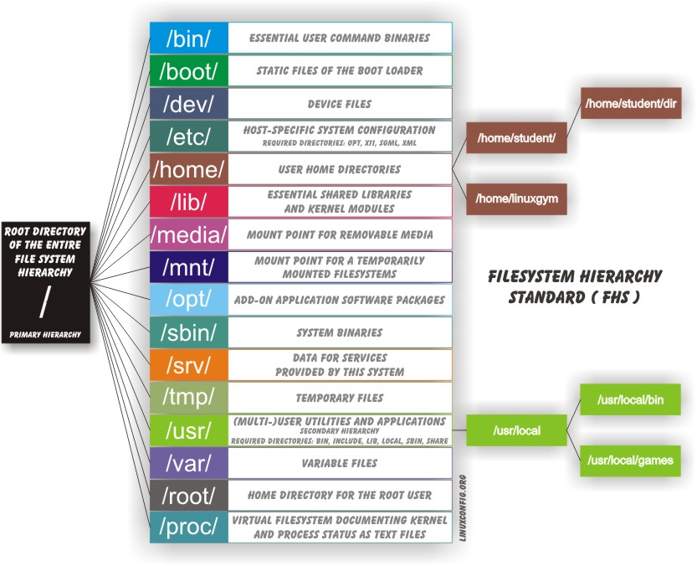
Filesystem Hierarchy Standard
What is it?

Slide 25
Linux Standard Base
What is it?

Slide 26
Section Feedback/Questions

Slide 27
The Flavors ?
Notes:
Explaining Why We Don't Endorse Other Systems

Slide 28
Distributions
Linux distribution
Comparison of Linux distributions
List of Linux distributions
Light-weight Linux distribution
DistroWatch.com: Put the fun back into computing. Use Linux, BSD.
Notes:
Rolling vs. Fixed release Linux Distros? Which one is Best for You?

Slide 29
Package Manager
Package manager
List of software package management systems
Arch: Creating packages
Debian Packaging Tutorial
aptitude user's manual
https://salsa.debian.org/debian/bash/-/commits/debian/master
4. Packaging New Software — Ubuntu Packaging Guide
Flatpak & Snappy (package manager)

Slide 30
File Systems
Filesystem in Userspace
List_of_file_systems
Comparison of file systems
Funtoo Filesystem Guide, Part 1

Slide 31
File Managers
Comparison of file managers
Midnight Commander
Dolphin (file manager)
GNOME Commander
GNOME Files

Slide 32
Shells
Comparison of command shells
Unix shell
Oh My Zsh - a delightful & open source framework for Zsh
fish shell
closh/scripting.md at master · dundalek/closh
the xonsh shell — xonsh 0.9.13 documentation

Slide 33
Bootloaders
Bootloader
Gentoo: Configuring the bootloader

Slide 34
Desktop Environments
Comparison of X Window System desktop environments
X Window System
Wayland (display server protocol)
Notes:
https://en.wikipedia.org/wiki/The_Unix-Haters_Handbook

Slide 35
Display Managers
X display manager
Simple Desktop Display Manager
LightDM
GNOME Display Manager

Slide 36
GUI Development
List of widget toolkits
Overview
VLC: Interfaces
The GTK Project - A free and open-source cross-platform widget toolkit
Qt for Python — Qt for Python
wxPython Bookshelf

Slide 37
Section Feedback/Questions

Slide 38
Deep Dive ?

Slide 39
Getting Started
The Best Keyboard Shortcuts for Bash (aka the Linux and macOS Terminal)
Data Science at the Command Line

Slide 40
GNU Core Utils
GNU Coreutils
BusyBox & BusyBox Products
https://packages.debian.org/jessie/utils/coreutils
https://www.archlinux.org/packages/core/x86_64/coreutils/
https://packages.gentoo.org/packages/sys-apps/coreutils
Notes:
https://en.wikipedia.org/wiki/List_of_Linux_distributions_that_run_from_RAM

Slide 41
GNU Find Utils
Finding Files
Notes:
find . -mtime +0 # find files modified greater than 24 hours ago
find . -mtime 0 # find files modified between now and 1 day ago # (i.e., in the past 24 hours only)
find . -mtime -1 # find files modified less than 1 day ago (SAME AS -mtime 0)
find . -mtime 1 # find files modified between 24 and 48 hours ago
find . -mtime +1 # find files modified more than 48 hours ago

Slide 42
Util Linux
https://en.wikipedia.org/wiki/Util-linux
karelzak/util-linux
util-linux

Slide 43
ProcPS
https://gitlab.com/procps-ng/procps
http://man7.org/linux/man-pages/dir_by_project.html#procps-ng

Slide 44
Net tools
https://www.gnu.org/software/inetutils/manual/html_node/index.html
http://man7.org/linux/man-pages/dir_by_project.html#net-tools

Slide 45
IP Utils
http://man7.org/linux/man-pages/dir_by_project.html#iputils

Slide 46
Curl
Everything curl: Introduction

Slide 47
Portable OpenSSH
https://github.com/openssh/openssh-portable
http://man7.org/linux/man-pages/dir_by_project.html#openssh

Slide 48
Bash Shell
Bash Reference Manual
bash.git - bash
Bash-it/bash-it: A community Bash framework.
https://opensource.com/article/18/3/creating-bash-completion-script

Slide 49
Section Feedback/Questions

Slide 50
Where to from here ?

Slide 51
Moreutils
sys-apps/moreutils
moreutils

Slide 52
Information Sources
https://ma.ttias.be/cronweekly/
https://github.com/luong-komorebi/Awesome-Linux-Software
https://github.com/madbob/awesome-linux-dev

Slide 53
Thank You

